Slide 1

Don’t Lien on me! A Primer on irs and nys tax and estate tax liens
Scott Kestenbaum, Esq.
Jill S. Monoson, Esq.

Slide 2
Kestenbaum & Mark LLP Civil and Criminal Tax Controversy Practice
Assistance with Individual and Business Tax Audits
Federal and State Tax-Related Internal Investigations
Civil and Criminal Tax Investigations
Defense of Accountants and Tax Return Preparers
Tax Whistleblower Representation
Federal Tax Liens, Levies and Seizures
New York State and New York City Tax Warrants, Levies, and Seizures
Collection Due Process Hearings
Collection Appeal Requests
Installment Agreements
Offers in Compromise
Appeals and Conciliation Conferences
Sales and Use Tax matters
Responsible Person Assessments
Innocent and Injured Spouse Relief
Passport Revocation For Seriously Delinquent Tax Debt
Federal, State and City Offshore and Domestic Voluntary Disclosures
Foreign Bank Account Reporting (FBAR)

Slide 3
Kestenbaum & Mark LLP Estate Planning and Administration
Estate and Tax Planning
Preparation of Wills and Trusts
Preparation of Powers of Attorney, Health Care Proxies, and Advance Health Care Directives
Business succession planning
Probate proceedings
Administration of trusts and estates
Formation of Entities including partnerships, corporations and limited liability companies
Representation of individuals and entities in all aspects of gift and estate tax planning
Representation of individuals and fiduciaries in Surrogate’s Courts proceedings
Representation of individuals and fiduciaries in State and Federal gift and estate tax audits

Slide 4
Agenda
What is a Tax Lien?
IRS Discharge of Federal Tax Lien Application
NYS Release of Lien Application
Estate Tax Liens
Questions

Slide 5
IRS Tax Collection How a Tax Liability Arises
In order for the IRS to begin collection, the tax must first be assessed (Set forth in IRC §§ 6201 through 6207)
Assessment Process: An assessment of tax is “the formal recording of a taxpayer’s tax liability” on the IRS’s records. Baltic v. Commissioner, 129 T.C. 178, 183 (2007).

Slide 6
IRS Tax Collection How a Tax Liability Arises
Self- Assessment (IRC § 6201(a)): TP voluntarily files a tax return (or amended return) reporting a tax due and owing, and the IRS records that liability
Special deficiency procedures of IRC § 6212 et seq., for income, estate and gift taxes:
Traditional Audits: IRS may propose to assess additional tax;
Automated Underreported Program: the IRS relies on third-party matching to detect noncompliance;
Substitute Returns (§ 6020(b)): If TP fails to file a return, the IRS can match information returns with TP’s identification number and prepare substitute returns and issue a notice of deficiency to assess tax due;
Jeopardy Assessment Process (§ 6861 and § 6862): used if IRS believes assessment or collection will be jeopardized by delay, IRS can immediately assess;
Termination Assessment Process (§ 6851): used if IRS believes TP will flee country, IRS can immediately assess;
Trust Fund Recovery Penalty: see Slide 56, or
As otherwise allowed by IRC § 6201 through § 6207

Slide 7
IRS Tax Collection Limitations on Assessment
Period of Limitation: tax must be assessed within three (3) years after a return is filed or the due date for filing the return, whichever is later
Exceptions to Period of Limitation
By Agreement (§ 6501(c)(4)): can be extended by agreement between TP and IRS
Both IRS and TP must agree before statute expires
IRS has burden of proof to show agreement extended statute
Forms used to extend statute:
Form 872: extends to specific date
Form 872-A (indefinitely until 90 days after IRS or TP receives Notice of Termination from other party (Form 872-T) or until IRS sends Notice of Deficiency
Form 872-P: extends time to assess tax attributable to partnership items

Slide 8
IRS Tax Collection Limitations on Assessment
False or Fraudulent Returns: IRS may assess tax or a court proceeding for collection of tax if:
§ 6501(c)(1): TP filed a false or fraudulent return with intent to evade tax
§ 6501(c)(2): TP willfully attempted to evade tax
§ 6502(c)(3): TP failed to file a return
*There is no Statute of Limitations for Civil Tax Fraud!
25% Omission & Foreign Financial Assets § 6501(e): statute of limitations extended to 6 years if:
TP omits gross income of 25%+ from filed return
TP omits $5,000+ from gross income that is foreign-sourced

Slide 9
IRS Tax Collection Limitations on Assessment
Notice of Deficiency: If IRS determines a deficiency in tax, IRS is authorized to send a notice of deficiency to the TP by registered or certified mail (§ 6512(a))
Valid only if it is issued before expiration of appropriate statute of limitations
IRS cannot assess deficiency until:
Notice has been mailed to the TP AND
Time for filing petition with Tax Court has expired (90 days generally, or 150 days if addressed to person outside of USA)
What if Petition is filed with the Tax Court? The IRS may not assess deficiency until 60 days after Tax Court decision is final (or 150 days if no Petition filed)

Slide 10
IRS Tax Collection Devices
Collection Follows Assessment: Once tax is assessed and the TP fails to pay the liability, IRS begins collection process
§ 6301: IRC directs the Commissioner to collect the taxes imposed by the internal revenue laws
Congress authorized the Commissioner to effect tax collection, by, in addition to other methods, liens and levies

Slide 11
IRS Tax Collection Devices Liens § 6321
IRC § 6321 imposes a lien in favor of US on all property and property rights of TP who is liable for taxes
*Lien arises at time of assessment and continues until assessed amount is satisfied or unenforceable due to statute of limitations expiration
Collateral Sanctions
Trend among some states has been to impose collateral sanctions, such as suspension of driver’s license or refusal to renew car registration
If you owe the IRS more than $55,000.00, the IRS will certify that debt to the State Department for action. The State Department generally will not issue a passport to you after receiving certification from the IRS.

Slide 12
IRS Tax Collection Devices Discharge of Federal Tax Lien
A Certificate of Discharge under IRC § 6325(b) removes the United States’ lien from the property named in the certificate
*Tip: This application can be used to release a lien even if there are not sufficient net proceeds from the sale to full pay the IRS balance due
Documents Required for Submission:
File IRS Form 14135
Fully Executed Contract of Sale;
Title Report;
Professional Appraisal;
Informal Valuation of Property (i.e. a letter from a real estate broker); and
Closing Statement (draft statement regarding the expected closing date, who will be paid at closing and the approximate amount the IRS will receive - the IRS used to require a HUD Settlement Statement, but will now accept a word document).
After the Discharge Application is filed:
The case is assigned to an IRS Advisory Agent who will issue the Conditional Commitment Letter shown on the subsequent slide.
This letter is then given to the title company so that the file can be cleared to close by the underwriter.
After closing, a copy of all closing documents and any net proceeds from the sale are mailed to the IRS, and the IRS releases any liens filed against the property

Slide 13
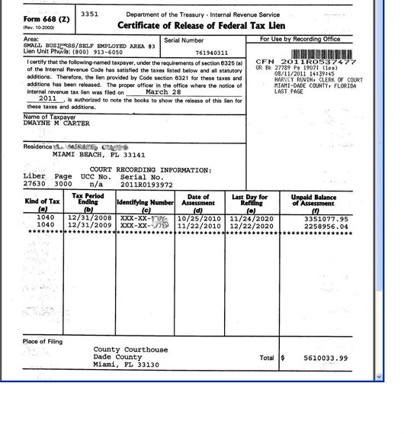
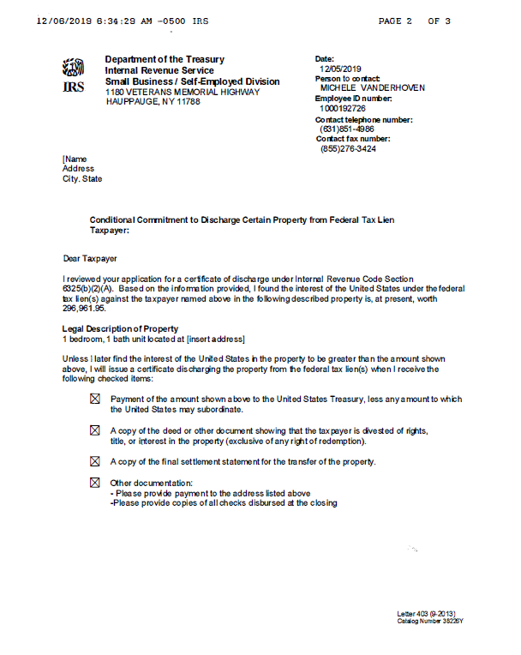
IRS Tax Collection Devices Discharge of Federal Tax Lien

Slide 14
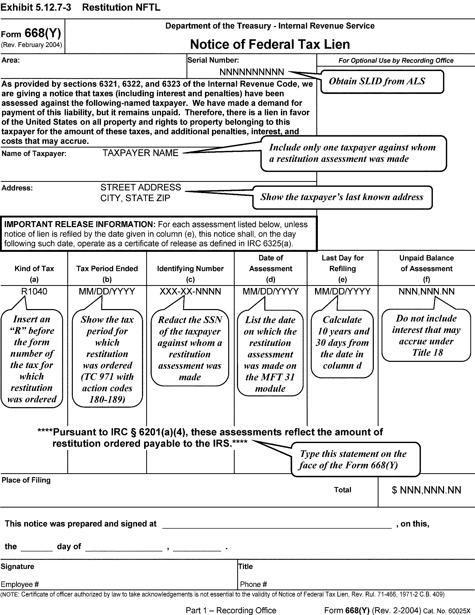
IRS Tax Collection Devices Discharge of Federal Tax Lien along with Restitution
In circumstances where the balance owed to the IRS derives from restitution from a criminal tax case, the process for discharge is more complicated
*Tip: there is a unit in Texas that monitors the payment of restitution (organized by first letter of the TP’s last name) and can be contacted to work with you to ensure proper release of liens from the sale of real property

Slide 15
NYS Tax Collection Devices Tax Warrant
Tax Warrant is equivalent to a civil judgment against a TP and protects New York State's interests and priority in the collection of outstanding tax debt.
New York State files a tax warrant with the appropriate New York State county clerk’s office and the New York State Department of State, and it becomes a public record.
A filed tax warrant creates a lien against your real and personal property, and may:
Allow NYS to seize and sell a TP’s real and personal property;
Allow NYS to garnish a TP’s wages or other income;
Affect a TP’s ability to buy or sell property, or
Affect a TP’s ability to obtain credit
*Tip: use this link to search for a NYS Tax Warrant: https://www.tax.ny.gov/enforcement/warrant-search.htm

Slide 16
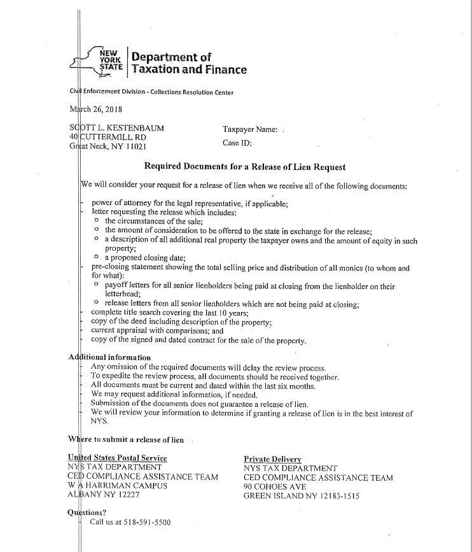
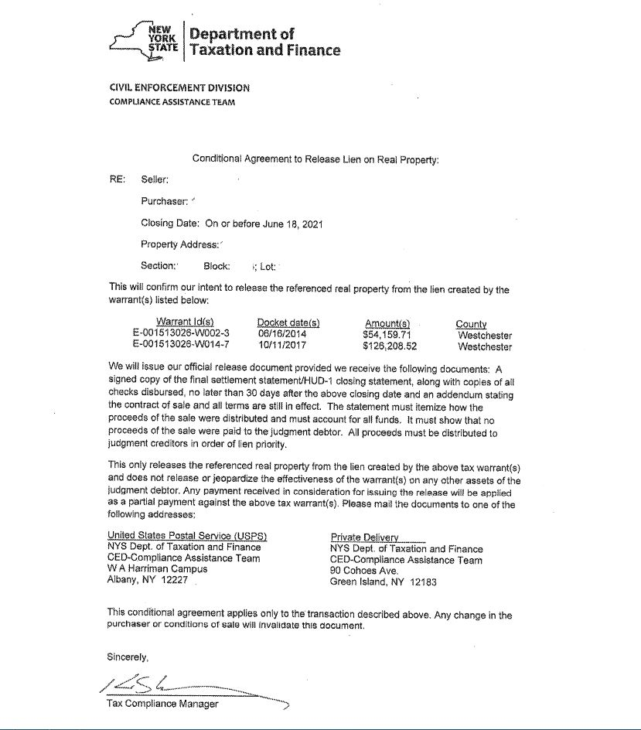
NYS Tax Collection Devices Release of Lien Request
Application
Conditional Commitment Letter

Slide 17
What if the Title Report shows IRS and NYS Liens?
If the title report shows IRS tax liens that have priority to NYS liens:
First: send in an IRS Discharge Application
Second: submit the NYS Release of Lien Application with a copy of the IRS Conditional Commitment Letter
*Tips:
NYS will approve a conditional commitment letter even if there are no net proceeds left after the IRS is paid
NYS and the IRS will approve a conditional commitment letter even if there are no net proceeds to pay either government agency

Slide 18
Should the Lien/Warrant be Released? Fact Pattern #1
Facts: The taxpayer and her husband originally purchased the home as tenants by the entirety. The husband accrued liabilities from a prior business and was assessed as a responsible person. NYS filed a tax warrant against the husband. In 2016, the husband died. In 2018, the wife tried to sell the home but NYS still had a tax warrant on record.
DID NYS GRANT THE RELEASE OF LIEN?

Slide 19
Should the Lien/Warrant be Released? Fact Pattern #1
Result:
In a tenants by the entirety form of ownership, each person owns a 100% undivided interest in the property. When one of the spouse-owners dies, the surviving spouse immediately takes the entire estate, not by transfer, but by operation of law and that the surviving spouse becomes the owner of the whole property. Estate of Violi, 65 N.Y.2d 392, 395 (1985); Kahn v. Kahn, 43 N.Y.2d 202, 207 (1977).
When the husband passed away on June 4, 2016, his interest was extinguished along with an encumbrance on his interest and the wife became the sole owner of the property without being subject to any prior encumbrance on his prior property interest.

Slide 20
Should the Lien/Warrant be Released? Fact Pattern #2
Facts:
Husband and Wife purchased a home in 2005
NYS filed a tax lien in 2016 against the property for taxes owed by the husband for tax years 2013 and 2014.
Husband and wife were divorced in February of 2017.
The Divorce Stipulation says:
The husband agrees to convey to the wife a Bargain and Sale Deed to the premises so that the wife becomes the sole owner of the property.
There are federal tax liens owed for tax years 2009, 2010, 2012, 2013 and 2014, and “the Husband assumes all responsibility and liability for the payment of all existing tax liens encumbering the premises including any that may hereafter attach due to Husband’s personal and/or business tax liabilities, and the Wife shall have no responsibility therefore.”
In addition to the Stipulation, the husband also signed an Escrow Agreement where he agreed to pay all outstanding federal and state tax liens from commissions/equity interest payments received from his entity.
DID NYS GRANT THE RELEASE OF LIEN?

Slide 21
Should the Lien/Warrant be Released? Fact Pattern #2
Result:
NYS comes before the Divorce!
At the time that the property was transferred to the wife, the wife’s divorce lawyer should have done a title search and explained to the wife that she was receiving a property subject to the tax warrant
It unfortunately does not matter that there was an escrow agreement regarding payment of the liabilities through the proceeds of the husband’s real estate transaction – at the time that the property was transferred, NYS can take the position that the husband’s 50% interest was being transferred to the wife without payment of the liability.

Slide 22
IRS Tax Collection Devices Collection Notices Tips
Determine if the liability is correct
Were the liabilities discharged in bankruptcy?
Seek the advice of a bankruptcy attorney
Did the statute of limitations expire?
10 years from the date of assessment for IRS
20 years from the date of assessment for NYS – but a warrant filed by NYS expires after 10 years if not refiled!
Is there reasonable cause to abate the penalties?
IRM 20.1.1.3.2
NYS Section 2392.1
Is the TP an Innocent Spouse?
IRC § 6015
NYS Section 654(a)
Tools to Confirm Validity of Assessment
IRS Account Transcripts
NYS Consolidated Statements

Slide 23
Estate tax liens
Think ahead!
Be prepared!

Slide 24
Estates with Real Property (or cooperative apartments)
Most estates contain real property or cooperative apartments.
Look at Will or Trust for disposition of real estate. Are there specific bequests? Directions to sell?
Sale and closing of real estate (or cooperative apartments) by Executor (probate) or administrator (administration) is usually comparable to the process when a sales transaction is entered into among living individuals.
If you are the not the attorney handling the sale of real property or coop from an estate, make sure you are in contact with the attorney handling the transacation.

Slide 25
Important things to pay attention to when an Estate/Trust is selling real property/coop
Purchaser and title companies will ask for updated Letters of appointment (Letters Testamentary (probate) and/or Letters of Administration (Administration)).
Fiduciary must check to see if Letters of appointment have any limitations imposed by Court. Letters of appointment may reflect limited authority to collect assets. If sales price exceeds stated amount, the administrator or executor needs to apply to Court to allow for amended letters with increased authority.
Letters of appointment may indicate that the fiduciary is prohibited from transferring or selling the property without Court approval or the posting of a bond. If so, application must be made to the Court for authorization and setting of bond amount. Could delay a closing and the fiduciary should be aware of his/her credit rating and financial profile to make sure that he/she can qualify for the issuance of a bond.
Fiduciary should be familiar with the property being sold. Check for liens/judgments/building violations. Good idea for Fiduciary to do title search before entering into a contract to cure issues.
Once you determine you have authority to sell, turn your attention to NYS and IRS Releases of Lien.

Slide 26
NYS Release of Estate Tax lien
New York State Tax Law places a lien on the decedent's New York State real property (or cooperative apartment) to secure the payment of any estate tax due. This is automatic!
This estate tax lien is effective as of the decedent's date of death.
To transfer real property (or cooperative apartment) from Decedent's estate, you must request and then receive a release of lien from the New York State Tax Department.
The NYS Release of Lien is authorization to transfer the real property, located in New York State, free and clear of the estate tax lien. The lien applies only to real property located in New York State.
No fee applies to a release of lien.

Slide 27
When a NYS Release of Lien is required
NYS Release of Lien release of lien is necessary for all dates of death unless the decedent and surviving spouse held real property (or cooperative apartment) as the only joint tenants.
Whether or not a release of lien is required does NOT depend on value of the property.
Automatic lien under Tax Law §975
Applies to all NY property at death
Duration: 10 years (but in some cases, Title requires it beyond 10 years)
Must be released by NYS Department of Taxation & Finance (DTF)

Slide 28
How to ensure timely processing of an Application for a NYS Release of Lien
Don’t schedule your closing until you receive your stamped copy of the release of lien (if a release of lien is required).
Avoid delaying your closing – make sure your application is accurate and complete. Before you submit your application for a release of lien, double check that you have:
selected the correct forms (see chart that follows).
included all the required documents.
completed all the required sections.
Average processing time for a completed application is three to four weeks.
Allow an additional seven to ten business days for mailing.
Incorrect or incomplete forms and missing documents can add significant processing time.

Slide 29
How to apply for a New York State Release of Lien
To get NYS Release of Lien, you must file two (2) NYS forms AND all supplemental documents (see below).
File Form ET-117 AND one of the following:
One of these forms:
Form ET-30, Application for Release(s) of Estate Tax Lien,
Form ET-706, New York State Estate Tax Return (if we already have your return on file but you need to submit Form ET-117 and you are not amending Form ET-706, send only the first page of Form ET-706 and write "Copy for Lien Request" on it), OR
Form ET-85, New York State Estate Tax Certification.
PLEASE REFER TO THE CHART TO SEE WHICH OF THESE FORMS YOU NEED TO FILE
Practice Note: If you wish to designate a representative to receive confidential information on your behalf, see Form ET-14.
Link to NYS site with details: https://www.tax.ny.gov/pit/estate/release_lien.htm

Slide 30
Which form do I file with ET-117?
 |  | Which form should I use?
If | use | Required with Form ET-117, Release of Lien and Estate Tax – Real property or cooperative
you're the appointed executor or administrator of the estate, or the duly authorized representative of the executor, and fewer than nine months have passed since the date of death, Note: If you have applied for your letters testamentary or letters of administration but have not yet received them, use Form ET-85, New York State Estate Tax Certification, to request a release of lien. | Form ET-30, Application for Release(s) of Estate Tax Lien. | Complete the Estimated value of all assets of estate section. Submit an original or verified copy of the letters testamentary or the letters of administration. Attach a copy of the death certificate. Enter PTINs or social security numbers requested on any forms you submit (Tax Law, Article 26, section 977(A)).
the estate is required to file a New York State estate tax return, and either: the estate hasn't obtained an extension of time to file the estate tax return, and more than nine months have passed since the date of death; or the estate obtained an extension of time to file the estate tax return, and more than 15 months have passed since the date of death (the extension has expired), | Form ET-706, New York State Estate Tax Return. | Pay all tax due in full. Attach a copy of the death certificate. Enter PTINs or social security numbers requested on any forms you submit (Tax Law, Article 26, section 977(A)). Include all other supplemental documents (see Form ET-706-I, Instructions for Form ET-706). Note: if we already have your return on file but you need to submit Form ET-117 and you are not amending Form ET-706, send only the first page of Form ET-706 and write "Copy for Lien Request" on it.
the estate isn't required to file a New York State estate tax return, and either: no executor or administrator has been appointed; or more than nine months have passed since the date of death, OR the estate is required to file a New York State estate tax return, and either: fewer than nine months have passed since the date of death, and an executor or administrator has not been appointed; or more than nine but less than 15 months have passed since the date of death, and an extension of time to file the estate tax return has been granted, | Form ET-85, New York State Estate Tax Certification. | Submit Form ET-130, Tentative Payment of Estate Tax, if applicable. (If the estate is subject to tax, you may be required to make an estimated payment.) You must complete the Estimated net estate section. Notarize Form ET-85, New York State Estate Tax Certification. Submit a signed Form ET-85, New York State Estate Tax Certification. The form must be signed by the applicant, the executor, or an approved Power of Attorney. Enter PTINs or social security numbers requested on any forms you submit (Tax Law, Article 26, section 977(A)). Attach a copy of the death certificate.

Slide 31
Use ET-30 When
You are the appointed fiduciary or duly authorized representative and
Fewer than nine months have passed since date of death.
NOTE: Make sure to complete the estimated value of all assets of estate, submit a copy of letters of appointment and a copy of death certificate.

Slide 32
Use ET-85 if
The estate is not required to file a NYS estate tax return, and either:
No fiduciary has been appointed OR
More than nine months have passed since date of death,
OR
The estate is required to file a NYS estate tax return, and either
Fewer than nine months have passed since date of death and an executor or administrator has not been appointed or
More than nine but less than 15 months have passed since date of death, and an extension of time to file estate tax return has been granted.
Practice note: You must complete the “estimated net estate” section and make sure the form is signed and notarized and include a copy of the death certificate.
If the estate is subject to tax, you may be required to submit Form ET-130 to make an estimated payment.

Slide 33
Use ET-706 if
The estate is required to file a NYS estate tax return, and either:
The estate hasn't obtained an extension of time to file estate tax return and more than nine months have passed since date of death; OR
The estate obtained an extension of time to file estate tax return and more than 15 months have passed since date of death (extension has expired).
NOTE: If you are filing the ET-706, then make sure that all estate tax due is paid in full and include a copy of death certificate and all other supplemental documents required. If the State already has the return on file, then submit Form ET-117 and note you are not amending Form ET-706, send only the first page of Form ET-706, and write "Copy for Lien Request" on page 1.

Slide 34
Practical Tips for NYS Releases of Lien
Use the recorded deed and property tax bill to complete Form ET-117. If you are dealing with a co-op, make sure you have the exact name of the Cooperative Corporation.
file a separate Form ET-117 for real property and cooperative apartments, even if located in the same county.
Check that the estate's outstanding tax assessments are fully paid before applying for release of lien. The State will not process request for release of lien until all bills are paid.
Refer to Publication 55 when sending the forms because it is critical to send the forms to the correct address.
File Early! Processing time: 4–6 weeks
Ensure that the name and address on Form ET-117 are accurate and legible. Once processed, the address cannot be changed without submitting a new Form ET-117.
New York State doesn’t recommend using a private delivery address to request a release of lien. BUT if you are in a HUGE rush, refer to Publication 55 for address.
Practice Note: Refer to Publication 55, Designated Private Delivery Services to make sure that the address is current). NYS cautions that using a private delivery service to send a request for release of lien will delay the process

Slide 35
Federal Estate Tax Release of Lien
Like NYS, a Federal estate tax lien immediately arises and attaches to all of the property included in Decedent’s gross estate (whether or not property is part of the probate estate). (§6324(a)). Unlike other tax liens, no assessment, no notice, and no demand for payment are necessary to create the estate tax lien. The lien attaches at the time of the decedent’s death, before the tax is determined. Sometimes referred to as the “silent lien” - does not have to be recorded to be enforced.
Before you sell real property of a decedent’s estate you typically need the IRS to “discharge” that property from either the estate or the assessment tax lien. This is not proof of payment of Estate tax – the estate tax will be considered fully satisfied only when an investigation has been completed and payment of the tax, including any deficiency that has been determined (Reg.§301.6325-1(c)(1)).
IRS will only issue a Release of Lien from Federal Estate tax for estates that are required to file Estate tax returns.
IRS Lien Arises automatically at death
Attaches to all property in the gross estate
Duration: 10 years (could be more)…
Released via Form 792 or IRS Letter 1352

Slide 36
Getting Federal Release of Lien (for taxable estates) Form 4422
Form 4422 Application for Certificate Discharging Property Subject to Estate Tax Lien
Submit application at least 45 days before transaction date for which discharge is needed.
Attach a statement giving your reasons for applying for this certificate. NOTE: If the IRS has issued any other discharges on this estate, include the dates and the amounts.
Attach any of the following documents that apply (err on the side of giving too much!)
Letters of Appointment (Letters Testamentary or Letters of Administration).
Complete Legal description of property/copy of Deed
Copy of Will or Trust;
Copy of sale contract
closing statement (or proposed closing statement),
Copy of the current title report
Appraisal or basis for valuation
Copy of the Form 706 with schedules (If return not yet filed, send draft Form 706, and/or a copy of the inventory and appraisal reflecting all estate assets or if on extension, copy of Form 4768.
Check Form 4422 instructions in case their requirements have changed!!!!

Slide 37
Forms 8821 and 2848 (not required, but helpful)
Form 8821, Tax Information Authorization
Completing 8821 gives IRS authority to contact individuals or companies, if necessary, when determining if the discharge is appropriate.
Form 2848, Power of Attorney
Practice Tips: Use Form 2848, Power of Attorney and Declaration of Representative when you want to authorize an individual to represent you before the IRS
I usually have clients sign both - IRS may request additional information to determine whether to issue the certificate. Having a 8821 and 2848 is helpful so you don’t have to bother client.
Submit the completed Form 4422 and all supporting documents to*:
Internal Revenue Service
Advisory Consolidated Receipts
7940 Kentucky Drive, Mail Stop 2850A
Florence, KY 41042-2915
Attn: Group Manager
E-fax number: 844-201-8382
Check for for updates to address/fax – they change!
If you get stuck, call IRS Estate tax advisory group – 669-229-1504. The usually return calls!

Slide 38
What if no Federal Estate tax return is required?
Unlike New York State, the IRS will typically NOT issue a release of Lien if the Estate is not a taxable Estate.
If IRS determines that the estate was not required to file an estate tax return, they will not issue a discharge certificate.
IRS will issue Letter 1352, Request for Discharge of Estate Tax Lien.
To get Letter 1352, complete Form 4422 and provide a copy of Letters of appointment, a list of assets the decedent had an interest in as od death of death, date of death values and a copy of a sales contract.
If Title company and/or management/transfer agent (coop) is requesting a Federal Release of Lien for an estate that is not taxable, ask if an Affidavit will suffice (sample attached).
Most Title companies will accept an Affidavit of no tax (sample attached). Coops usually require Letters 1352 for non taxable estates.

Slide 39
Is an Escrow Agreement Required?
In 2016, IRS began requiring additional documentation beyond what was explicitly required in the instructions to Form 4422. In some cases, IRS began insisting on appraisals of property and reviewed proposed closing statement, with focus on attorney’s fees/broker commissions
ESCROW: In 2016, for many taxable estates, IRS began insisting either that the net proceeds of sale be paid over to IRS or that estate enter into an escrow agreement with an escrow agent where escrow agent retains funds until federal estate tax return was filed and IRS completed its review of the return by issuing a closing letter to the executor of the estate.
If Form 706 had not yet been filed or if the IRS had not completed review of Form 706, they determined on a case-by-case basis amount of funds, if any, estate was required to either pre-pay from sale proceeds or held in escrow.
If Form 4422 indicates that the estate tax return will be non-taxable, based upon the estimated gross estate and estimated deductions, then a discharge without an escrow may be appropriate. BUT the IRS has discretion to question the deductions before they issue a Release of Lien.
PRACTICE NOTE: Lately, the IRS has not been requiring the escrow and they have been issuing the Releases of Lien quickly.

Slide 40
Coordinating IRS and NYS Filings
File Form 4422 / Letter 1352 and ET-117 together
If no filing required:
Request Letter 1352 (IRS)
Ask Title or transfer agent if they will accept an Affidavit of Nontaxable estate
Last resort -Use escrow if tax not yet finalized

Slide 41
Practical Tips THINK AHEAD
If the Estate is not taxable (even for NYS), ask the Title company or Managing Agent or attorney for cooperative apartment if they will accept an Affidavit in lieu of a Release of Lien. Sample Affidavit is attached. It cannot hurt to ask!
I have several “war stories” where I get a call from Client who is selling Real property from an Estate and they are using an attorney who has “never heard of a “Release of Lien”. I am tasked with getting the Release of Lien and Closing has already been scheduled.
If you know you are going to be selling real property in an estate and the Fiduciary needs to file an ET-706, tell the person preparing the ET-706 to request the Release of Lien when they file the ET-706. You can request a NYS Release of Lien even if you do not have a contract for sale.
NYS Release of Lien does NOT expire and does not require a contract for sale. So, if your clients are fiduciaries with real property (or coops), get the Release of Lien when the Estate tax returns are being filed. On the ET-706, there is a box to check. (see attached page 1 of ET-706).

Slide 42
Key Takeaways
Estate tax liens arise automatically at death
Releases required for property transfers
IRS: Form 4422 → Form 792 or Letter 1352
NYS: Form ET-117 → Certificate of Release
Co-ops treated like real property
Early coordination prevents closing delays

Slide 43
Forms Attached
Redacted ET-117
Sample Affidavits for Title Company
Form 4422
Redacted Form 792
Redacted Letter 1352

Slide 44
Form ET-117

Slide 45
Sample Affidavits for Title Company

Slide 46
Form 4422

Slide 47
IRS Form 792

Slide 48
Letter 1352

Slide 49
Questions?
Kestenbaum & Mark LLP
40 Cuttermill Road, Suite 300
Great Neck, NY 11021
Phone: (516) 466-0410
Fax: (516) 829-3729
Email: scott@kmtaxlaw.com
jmonoson@kmtaxlaw.com

