Slide 1
Lawyers, Financial Professionals, and Mental Health Concerns:
Making the case for change

Slide 2

Amanda Koplin, LPC
Licensed Professional Counselor
Certified Hostage Negotiator
Mental Health and Family Coach
Industry Expert and Speaker
Trainer and Advisor
Fiduciary and Trusted Advisor Consultant

Slide 3
Trigger Warning:
Mental health is a topic which deeply impacts each one of us. If you find yourself triggered by any of the material we discuss today, there are resources listed at the end of this presentation and I will be available to talk to anyone who has questions or needs help following the presentation

Slide 4
Why is this topic important?
Please raise your hand if you know someone, or are someone, impacted by mental health challenges?

Slide 5
Statistics:
(ALM 2023 Mental Health Survey)
Nearly 3,000 lawyers answered questions related to well-being and the relation to law firms’ culture and policies.
Pandemic stress, economic uncertainty, and billable hours pressure have been a potent combination hindering mental health efforts in many law firms.
More than 50% of the respondents said they felt increasingly cynical and a decreased sense of accomplishment.
60% felt overwhelmed and exhausted.
More than 75% said their work environment contributed to their mental health issues, with the top reasons being billable hours pressure, the 24/7 pace of the work, and client demands.
https://www.forbes.com/sites/pauladavis/2023/05/18/lawyer-strong-the-legal-professions-journey-toward-well-being/?sh=638e93322b0a

Slide 6
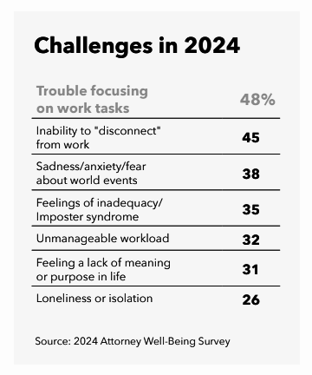
What Lawyers Self-Report:
28% experienced depression
19% reported anxiety
21% had alcohol use problems
11% had problems with drug use
Krill, P. R., Thomas, H. M., Kramer, M. R., Degeneffe, N., & Anker, J. J. (2023). Stressed, lonely, and overcommitted: Predictors of lawyer suicide risk. Healthcare, 11(4), 536. https://doi.org/10.3390/healthcare11040536

Slide 7
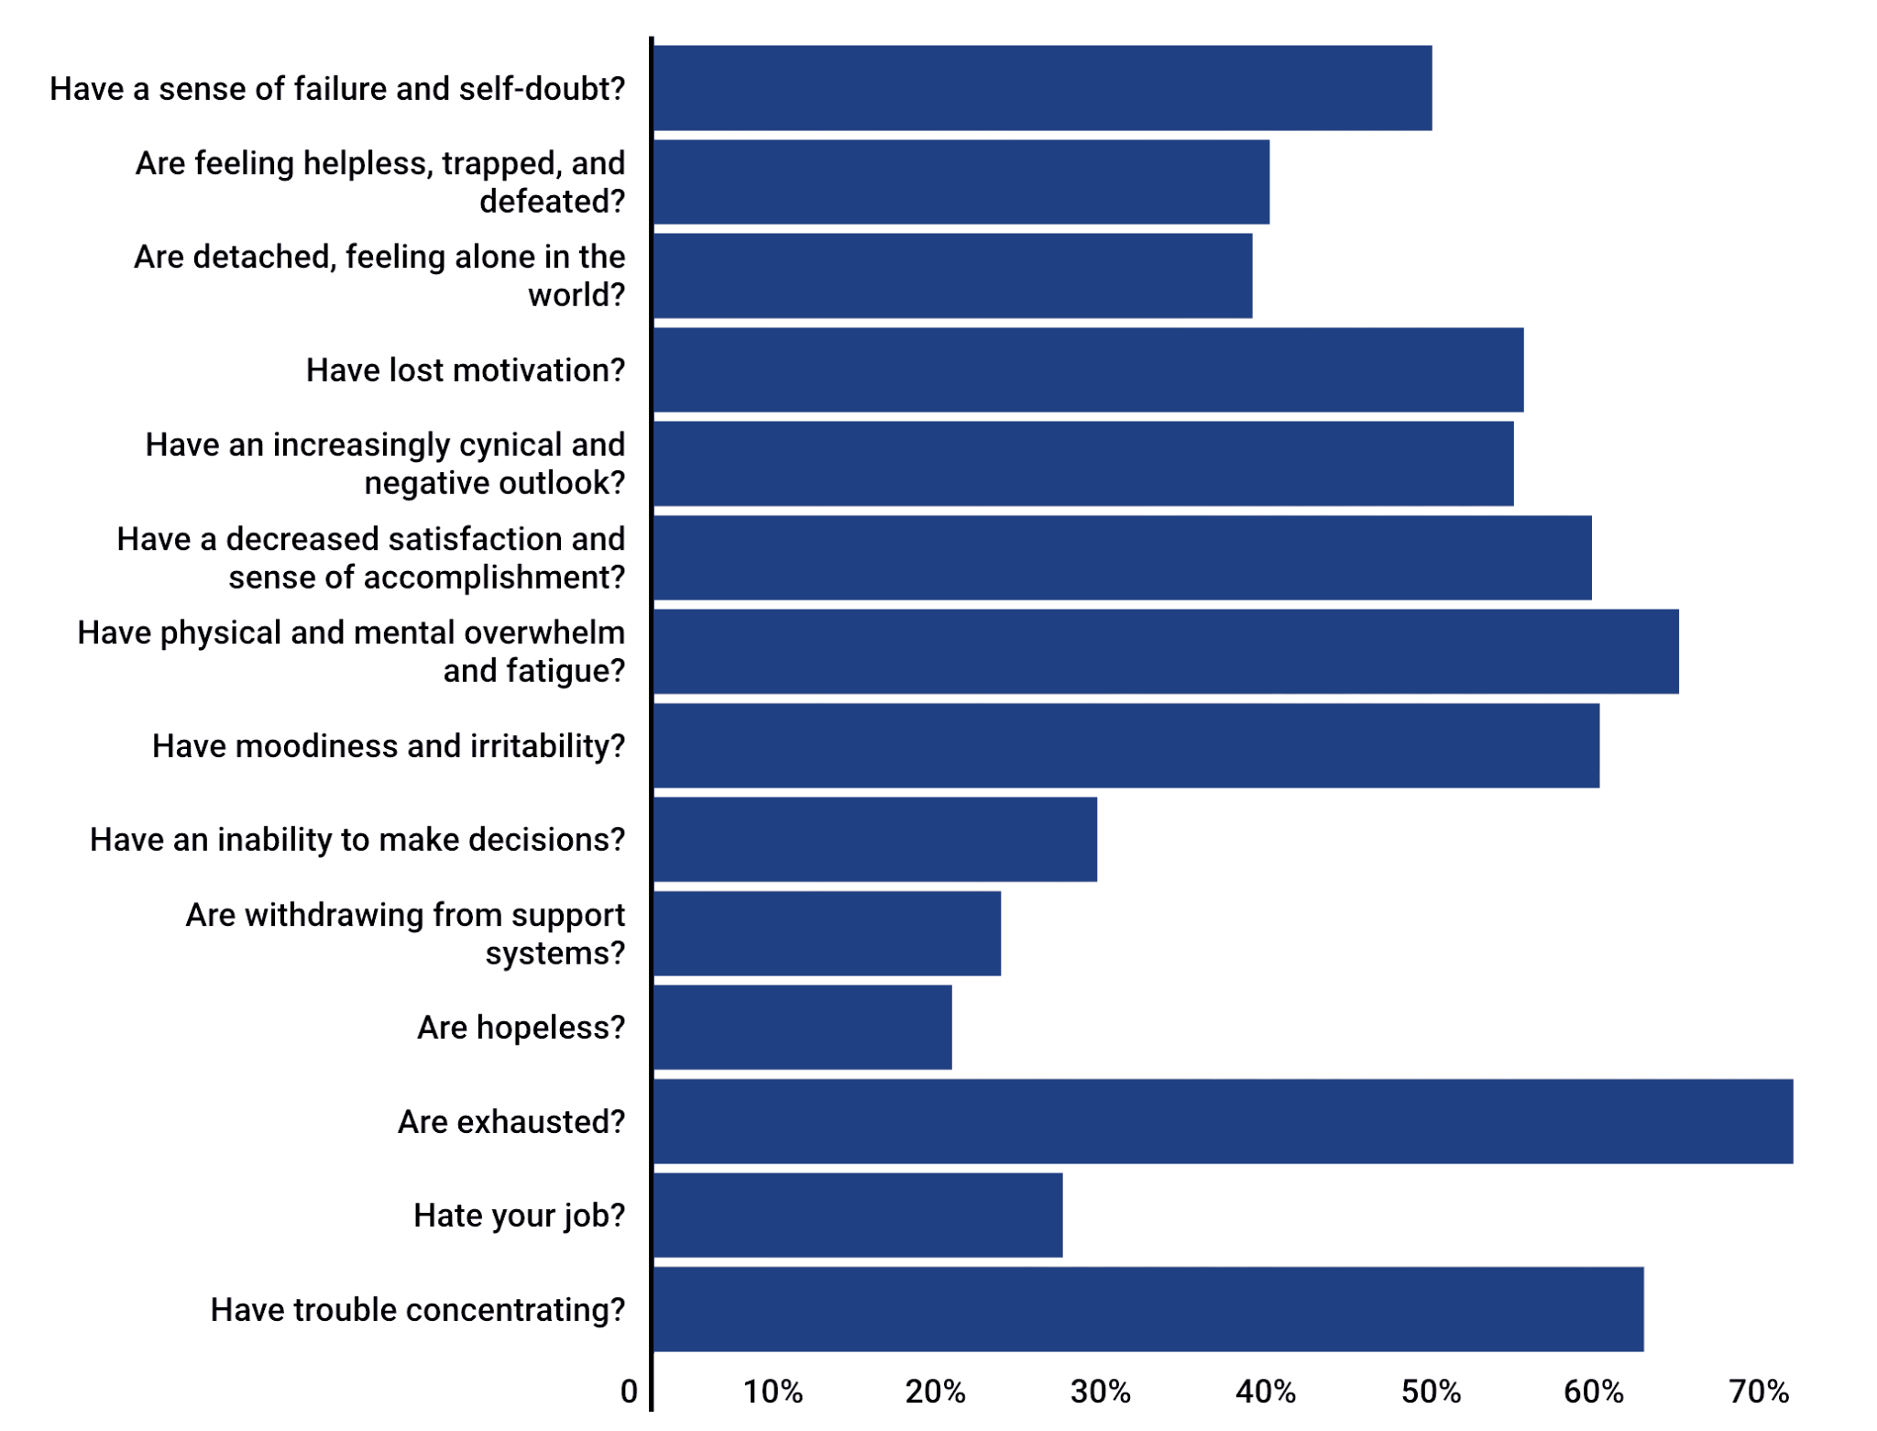
Do you feel you . . .
https://www.law.com/americanlawyer/2024/05/17/mental-health-by-the-numbers-the-2024-survey-infographic/
Notes:
2,500 lawyers surveyed

Slide 8
Substance Abuse in Lawyers
ABA & Hazelden Betty Ford Study (2016):
21% initially identified as problem drinkers
When asked more specifically, over 36% acknowledged struggling with alcohol abuse
Almost ½ of lawyers stated their drinking problem began in the first 15 years in the industry, including time in law school

Slide 9
Financial Advisors and Stress
Financial advisors experience more stress than both the investors they serve and the general population.
Survey Findings (Financial Planning Association, Janus Henderson, Investopedia):
71% of advisors report moderate (34%) or high negative stress (37%)
Compared to 63% of investors
Stress is Increasing Over Time:
28% feel more stressed than 12 months ago
44% feel more stressed than five years ago
Impact & Need for Change:
84% believe stress reduction would positively impact both business & personal life
(https://www.cnbc.com/2019/05/22/financial-advisors-are-more-stressed-out-than-their-clients-study.html)

Slide 10
Financial Advisors and Stress Cont’d
Many independent RIA financial advisors worry about their business’s health and future.
Survey Findings (Financial Planning Association):
  Only 18% are satisfied with their business’s profitability
  Only 15% are satisfied with its growth trajectory
Biggest Stressor:
  Struggling to balance business growth with personal life

Slide 11
Key Stressors for Financial Advisors
Major stressors identified:
  Fee compression, shrinking margins, and increasing competition
  Anxiety over their own financial situation and trajectory
  Staying on top of regulatory changes
Study findings:
  Strong correlation between negative stress and failure to achieve personal & professional goals
Advisors' own challenges they identified:
  Poor time management (35%)
  Their own mindsets (33%)

Slide 12
Additional Stressors Unique To Financial Advisors
Stress related to market volatility
Global economic shifts
The potential of losing someone’s retirement or fixed income
Client life shifts impacting financial needs (divorce, deaths, major career change)
The psychological rollercoaster of client reaction to market downturns/ volatility
AI potentially eliminating the need for human advisors

Slide 13
The People Behind The Numbers

Slide 14
Financial Professionals
Thomas Hughes, a 29-year-old investment banker at Moelis & Co., jumped from the 24th floor of his Manhattan apartment building. His father, in media interviews, talked about the stress and pressure his son was under at work and how he may have been using drugs and alcohol to cope.
Sarvshreshth Gupta, a 22-year-old technology, media and telecoms analyst at Goldman Sachs Group Inc. in San Francisco was found in a parking lot beneath his apartment building after jumping from an open window on the roof. His father, in an essay he wrote about his son, stated his son complained of the long work hours and saying, “I have not slept for two days, have a client meeting tomorrow morning, have to complete my presentation, my VP is annoyed, and I am working alone in my office.”
https://www.afr.com/markets/equity-markets/deaths-expose-wall-streets-ruthless-culture-20151005-gk17t4

Slide 15
Lawyers
Steve Angel, survived his battle with depression and now blogs about it. He considered suicide at one point in his career as client demands mounted and they became angry when he didn’t return their calls. Eventually, he was disciplined by the Oklahoma State Bar Association for failing to represent several of his clients. The pressure mounted and the depression increased. He locked himself in his home, hid from his life, and spent his days in bed. Fortunately, his survival allows him to be a voice and advocate for other struggling attorneys to let them know they’re not alone.
https://www.cnn.com/2014/01/19/us/lawyer-suicides/index.html

Slide 16
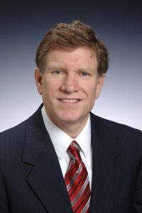
Ken Jameson, 58 yo, Estate Attorney
He was generating about $600,000 of billable hours for his law firm every year
“He was an attorney who facilitated resolutions and provided estate plans for people of all income levels”
“After joining the firm himself in 2006, his practice thrived. He became a trusted member of the firm and was on the management committee.”
“Ken Jameson was, by outward appearances, successful, well liked, a loving husband and father, a friend to everyone and a dependable partner. Ken was perhaps the epitome of the well liked, client centered and dedicated lawyer many of us envision when we think of how lawyers should behave”
“On the inside, however, Ken was struggling with the depression which eventually took his life.”

Slide 17
What Makes Them Tick?
The Personality Traits of Lawyers and Financial Professionals

Slide 18
Type A Personality Traits
Ambitious: tend to gravitate toward high risk, high reward activities. Tends to over prioritize work and achievement over relaxation and self-care
Self-worth comes more from accomplishments
Time urgency: this can create impatience with others and a hyperfocus on deadlines
Competitiveness: a desire to outperform others
Perfectionism: low tolerance for errors

Slide 19
Pros of Type A Personality Traits
Ability to complete tasks
Tendency to be more direct
Self-advocacy
https://www.forbes.com/health/mind/type-a-personality-traits/
Goal-oriented mindset
Resilience
Self-driven and proactive in their pursuits

Slide 20
Cons of Being Type A
Chronic stress, increased risk of burnout, anxiety
Strained social relationships and challenges connecting with others on a deep level
Difficulty delegating tasks
Excessive self-criticism and feelings of inadequacy
Difficulty with work-life balance
Rigidity in thinking
Increased risk of cardiovascular disease, hypertension, and sleep disturbances
https://www.forbes.com/health/mind/type-a-personality-traits11

Slide 21
The Dangers of Unbridled Pressure and Ambition
How Traits of Trusted Advisors and Expectations of the Environment Push People Too Far

Slide 22
The Reality for Lawyers
Incoming law students rank as one of the healthiest groups in the nation
As they go through law school and then enter their careers, status devolves, and they end up topping the charts as the group of professionals struggling with the highest rates of depression, anxiety, and addiction compared to both the general population and educated professionals
“An overwhelming majority of legal professionals believe their mental well-being is worse off as a result of their chosen career…”
Commonly co-occurring disorders in lawyers are exponentially greater compared to the general population.

Slide 23
The Reality for Lawyers (Cont’d)
According to the ABA report, the zealous adversarial nature of the legal system contributes to the high prevalence of mental and physical health problems.
Penalized for setting boundaries: According to the New York State Bar’s findings, attorneys reported that the greatest impact on their overall wellness was their inability to set boundaries and meet the demands of their clients. The inability to set healthy boundaries undermines our resilience.
According to the ABA task force, “Chronic incivility is corrosive. It depletes energy and motivation, increases burnout, and inflicts emotional and physiological damage. It diminishes productivity, performance, creativity, and helping behaviors."
https://www.psychologytoday.com/us/blog/building-resilient-minds/202203/why-the-legal-system-needs-prioritize-attorney-wellbeing

Slide 24
Ranking the highest isn’t always the best
Lawyers and financial advisors are in the top 11 group of professionals with the highest suicide rates
They also have unusually high rates of depression, anxiety, and substance use
High levels of stress, inadequate work-life balance, and high pressure to perform, all impact people’s ability to find their own sense of well-being, regulate sleep, emotions, and relationships

Slide 25

Ken and Betsy Jameson, Married 35 Years
Ken shared is life outside of the office with his wife and best friend of 35 years, Betsy, and three adult children of whom he was most proud.
Ken was a universally well liked person. He conducted himself professionally in such a way that he never seemed to have conflicts with others.
Ken cared about his firm family, he always checked in on people if they were sick or if he knew you were under stress.
He was active member in his Church.
Ken took care of his physical health by walking 5 miles a day, attending Pilates classes twice a week and maintaining a healthy diet. By all outward appearances, Ken had success in his work, a happy home life and seemed content.

Slide 26
Statistics
Identifying the Cultural Issue

Slide 27
Predictors of Suicidal Thoughts
Work Overcommitment:
Lawyers with high work overcommitment had 2.2 times higher odds of suicidal ideation.
Lawyers with intermediate work overcommitment had 1.6 times higher odds of suicidal ideation.
Loneliness:
Lawyers who screened as lonely on the UCLA Loneliness Scale were 2.8 times more likely to endorse suicidality.
Gender Differences:
Male lawyers were 2 times more likely to experience suicidal ideation than female lawyers.
Mental Health History:
Lawyers with a history of at least one mental illness diagnosis were 1.8 times more likely to endorse suicidality.
Perceived Stress Levels:
Lawyers with high stress levels were 22 times more likely to endorse suicidality.
Lawyers with intermediate stress levels were 5.5 times more likely to endorse suicidality.
Krill, P. R., Thomas, H. M., Kramer, M. R., Degeneffe, N., & Anker, J. J. (2023). Stressed, lonely, and overcommitted: Predictors of lawyer suicide risk. Healthcare, 11(4), 536. https://doi.org/10.3390/healthcare11040536

Slide 28
Psychological Safety
When employees feel psychologically safe — or secure in taking risks, acknowledging mistakes or concerns, and engaging in difficult conversations — they are nearly five times more likely to be confident about their career progression and opportunities, the report said.
Employees who feel supported by their managers are nine times more likely to say that work positively impacts their well-being, compared to those who don’t feel supported.
https://www.2civility.org/poor-lawyer-well-being-may-cost-firms-up-to-33m-survey-says/

Slide 29
The Culture of Silence:
But perhaps the most troubling data is that 6 out of 10 attorneys said that in the last six months they, at least sometimes, came across other legal professionals whose work responsibilities were affected by well-being, substance abuse, or mental health issues.
(Bloomberg Law, 2024 Attorney Well-being Report)

Slide 30
Why Is Change So Hard?
Nobody wants to admit they’re struggling because it bars them from promotions, makes them appear weak, and stigmatizes them in a “superman” culture.
Everyone else pretending they’re ok or that these symptoms are normal makes it an individual problem rather than a cultural problem
Fear of leadership prioritizing well-being coming at the cost of profits

Slide 31
When the only differentiator is sheer grit:
"They are doing it to themselves willingly because the competition is so fierce and anything they can do to stand out they are going to do," said Kevin Roose, the author of "Young Money," a 2014 book about young Wall Street bankers. "You can't really stand out because most of what you're doing does not require original thinking. So the only way you can distinguish yourself is by sheer endurance. Gluttons for punishment are rewarded on Wall Street, especially at the young levels."

Slide 32
The 2024 State of Wellbeing in Law survey by Unmind (4,000 lawyers surveyed)
28% of respondents believe that talking openly about mental health to their supervisors could harm their chance of progress.
27% are concerned about the confidentiality of mental health discussions with supervisors
1:3 employees do not trust their senior leaders to make decisions prioritizing employee well-being, an 11% increase from last year’s survey.
1:5 lawyers said work harms their mental health. Almost 19% of their time at work is negatively affected by poor mental health.
Associates, younger employees, and female employees experience higher stress levels, lower well-being, and lower psychological safety compared to their older and male counterparts.
These challenges can lead to law firms losing $33,336,720 annually, or just over 10% of staffing costs.
https://www.2civility.org/poor-lawyer-well-being-may-cost-firms-up-to-33m-survey-says/

Slide 33
Where Do We Go From Here:
Making The Case For Change

Slide 34
Actionable Ideas
Advocate for an overhaul of the systems and change the unrealistic expectations put on all professional advisers to be highly successful.
We need to stop rewarding the things that are killing people, have the courage to intervene when we see other advisors struggling, and reconstruct what it takes to be successful in advisory careers.
Firms could expand compensation considerations to include other factors that reward healthy behaviors, set reasonable caps on how many hours in a various time periods people can work, or borrow other successful ideas from other high stress industries.

Slide 35
Applying what works in other industries
Airline pilots are subject to strict work limitations. Federal Aviation Regulations require specified rest periods. Maximum work hours are imposed 30 flight hours in any 7 consecutive days, etc.
Train operators cannot go on duty, or be on duty, for an excess of 12 consecutive hours and require a minimum of 10 hours off duty during the prior 24 hours. They cannot work more than 6 consecutive days without 48 hours off.

Slide 36
Action Steps To Take Now
Real Steps Real Firms are Taking Now

Slide 37
Efforts By Major Financial Institutions
Goldman Sachs
Mandatory time off: No office work from 9 p.m. Friday to 9 a.m. Sunday
Strict monitoring: Only senior partners can authorize exceptions
Limited exceptions: Only 15-20 out of 1,500 analysts/associates may work on weekends for urgent deals
Barclays
Work limit: Analysts cannot work more than 12 consecutive days
JPMorgan Chase
"Protected weekend" policy: Analysts can take one full weekend off per month, if scheduled in advance
Bank of America
Minimum time off requirement: Employees must take at least four weekend days off per month
https://www.afr.com/markets/equity-markets/deaths-expose-wall-streets-ruthless-culture-20151005-gk17t4

Slide 38
Steps from Recent ALM article
Reducing the number of meetings and adding more structure to them.
Leveraging the many workload management resources the firm has available.
Burnout prevention teams and programming.
Talk about well-being and culture with its senior leaders.
Allows associates and special counsel to use up to 40 hours of billable credit time each year to rest and recharge.
Teach and prioritize leadership at the firm, specifically incorporating well-being principles.
Build a culture of appreciation.

Slide 39
Steps from Recent ALM article
Regularly debrief about important goals… the process of formally reviewing an event enhances team members’ sense of control and support.
Provide a rationale or more in-depth explanation for projects, goals, and vision. Ask a client to tell you his/her/its story and make sure that is shared with the team.
Be as clear as you can about the priority of assignments, status updates, clarity of assignments, and due dates.
https://www.forbes.com/sites/pauladavis/2023/05/18/lawyer-strong-the-legal-professions-journey-toward-well-being/?sh=638e93322b0a

Slide 40
Practical Tools for Financial Advisors
Practices which distinguish leading financial advisors from everyone else.
Centering their definitions of success around economic value they’re generating (including both income and equity in their practices), the impact they are having on their clients’ lives, AND their own quality of life.
Recognition that serving fewer clients allows them to spend more time building client relationships and ensuring client satisfaction. The outcome is greater client loyalty and referrals to qualified prospects.
  Creating a deliberate, formalized approach to gauging and catering to client satisfaction
  Asking clients directly for referrals
CEG WorldWide, in their Best Practices for Elite Financial Advisors: 2012 Report

Slide 41
Practical Tools for Financial Advisors Cont’d
Specialization in one particular type of client (ex: retirees, private-business owners, pre-retirees, corporate executives, inheritors, professionals (doctors, lawyers, architects, etc).
Recognition of importance of referrals from other professionals
Engage in business building practices
  Formal business plans
  Formal marketing plans
  Hiring a competent staff to free up their time and focus on highest value, highest return activities such as client-facing and business building activities.
CEG WorldWide, in their Best Practices for Elite Financial Advisors: 2012 Report

Slide 42
Practical Tools: Mindset
As work becomes more in balance, advisors can begin to place more boundaries on their time at work and add in activities which help increase their quality of life outside of work.
Advisors can also incorporate these tools for improving mindset:
Identify where you have control and where you don’t have control
Set clear expectations with clients regarding your time, their investment outcomes, frequency of communication, response time, and what you’re able to do to meet their expectations (You’ll be surprised at how people will respect and accept it if they’re informed)
CEG WorldWide, in their Best Practices for Elite Financial Advisors: 2012 Report

Slide 43
Practical Tools: Mindset Cont’d
Add in meditation, prayer, yoga, or another mindfulness practice
Time block out your priorities on your calendar
Start the day with identifying priorities so it’s not overrun with menial tasks and you end the day feeling accomplished
You can listen to personal problems clients are having in their lives without being responsible to fix it
CEG WorldWide, in their Best Practices for Elite Financial Advisors: 2012 Report

Slide 44
Conclusion and
Additional Information
Wrapping it up

Slide 45
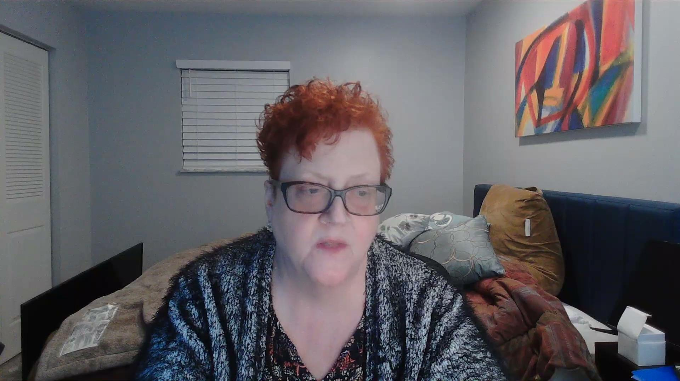
Tabitha M. Hochscheid, Esq., law partner to Ken

Slide 46
Conclusion
There are things we can do to protect the mental health of the lawyers and financial professionals who guide our futures with their decision making.
It starts with people no longer accepting the status quo and culture around exhaustion and silence as a badge of honor.

Slide 47
Resources
Directory of Lawyer Assistance Programs: https://www.americanbar.org/groups/lawyer_assistance/resources/lap_programs_by_state/
National Alliance on Mental Illness Hotline:
1-800-950-6264
Lawyers Concerned For Lawyers: https://www.lclma.org/resources/substance-abuse-and-chemical-dependency-resources/
Lawyers With Depression:
https://www.lawyerswithdepression.com/

Slide 48
Questions:
Amanda Koplin
Email: amanda@koplinconsulting.com
Cell: 210-865-2484
Website: koplinconsulting.com

